Slide 1
Smart grid advance metering infrastruction
CAPSTONE PROJECT
Presented By:
1. SUDHARSON.R-LOUDES MOUNT COLLEGE OF ENGINEERING AND TECHNOLOGY

Slide 2
OUTLINE
Problem Statement
Proposed System/Solution
System Development Approach
Algorithm & Deployment
Result
Conclusion
Future Scope
References

Slide 3
Problem Statement
Improving energy efficiency
Reliability and security of electricity distribution
Ensuring interoperability amoung different components protecting consumer

Slide 4
Proposed Solution
Implementing a comprehensive system that integrates advanced metering device with communication network and data management platforms.
This solution aims to provide real time data collection analysis and control capabilities to optimize energy usage detect fault and enable demand response programe

Slide 5
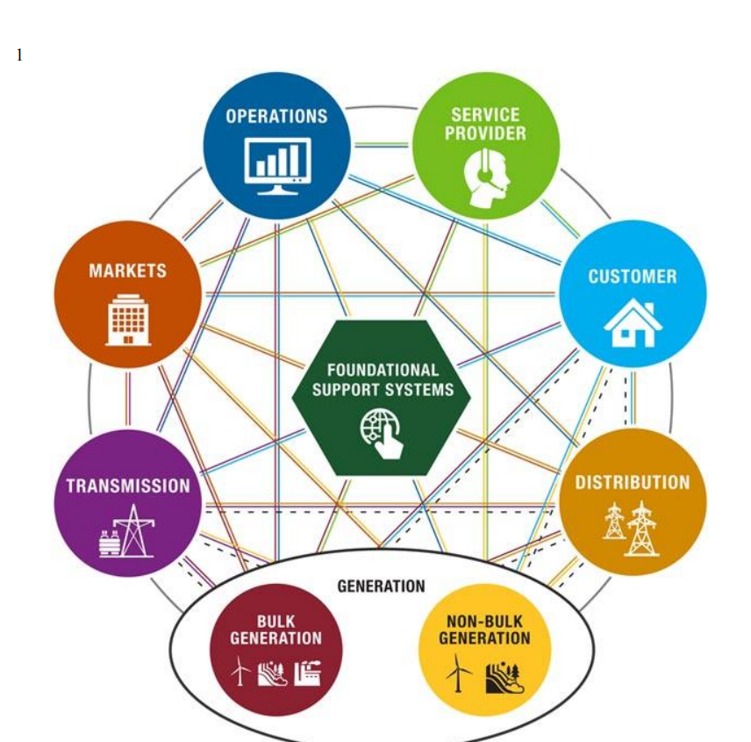
System Approach

Slide 6
Algorithm & Deployment
Assessment and Planning
Technology Selection
Network deployment
Meter installation
Data management system setup
Algorithm development
Integration and testing
Deployment
Training and education
Monitoring and maintenance

Slide 7
Result
Overall, the implementation of a smart grid advanced metering infrastructure results in a more efficient, reliable, and sustainable electricity distribution system that benefits both utilities and consumers alike

Slide 8
Conclusion
The implementation of a smart grid advanced metering infrastructure (AMI) offers numerous benefits, including enhanced grid reliability, improved energy efficiency, and better integration of renewable energy sources. Additionally, it enables more accurate billing, real-time monitoring, and greater control over energy consumption for both utilities and consumers. Overall, AMI plays a crucial role in modernizing the energy infrastructure and facilitating the transition towards a more sustainable and resilient energy system

Slide 9
Future scope
The future scope of smart grid advanced metering infrastructure (AMI) is promising, with ongoing advancements in technology and increased adoption worldwide. Future developments may include the integration of artificial intelligence and machine learning algorithms to optimize energy distribution, predictive maintenance, and demand forecasting. Additionally, the expansion of AMI to support more decentralized energy systems, such as microgrids and distributed generation, will further enhance its capabilities. Moreover, the emergence of smart appliances and electric vehicles will drive the need for interoperability and data analytics within the AMI framework, paving the way for a more efficient and sustainable energy ecosystem.

Slide 10
References
Title: “Advanced Metering Infrastructure and Energy Internet: A Review”
Authors: Wei Wang, Yusheng Xue, Zijun Zhang, Qingxu Deng, Jiankang Wang
Journal: Energies (Basel)
Year: 2018
Volume: 11
Issue: 12
Pages: 3423
DOI: 10.3390/en11123423
This review provides insights into the latest developments, technologies, and applications of advanced metering infrastructure within the context of the energy internet paradigm. It offers valuable information for understanding the current state and future directions of smart grid AMI.

Slide 11
THANK YOU

